Slide 1
Enterprise Agent Framework for Building Reliable and Self-learning AI Agents

Slide 2
The agent development capabilities of Langchain
Data privacy & product maturity of Snowflake

Slide 3
Introducing
Lyzr Universal Agent – The Most Capable Agent with Critical Enterprise Features
Lyzr’s Universal Agent helps convert probabilistic AI to a deterministic AI, enhancing accuracy and reliability.

Slide 4
With Lyzr Universal Agent, you can build
Adopt & Customize
Build From
Scratch
#1 Fully Autonomous Role Agents
#3 Custom Agents for Workflow Automation
Jazon - The AI SDR
Skott - The AI Marketer
Diane - The AI HR
Accounts receivable automation (AtScale)
Supplier contract management (NPD Powered)
Multi-product recommendation (Sanskriti)
Candidates inquiry handling (Stand8)
Cross-border meeting coordinator (Nelson Global)
System level risk assessment (Sagax)
Customer onboarding (Appointmate)
AI life coach (SurePeople)
Adopt & Customize
#2 Single Task Bots
Chatbot
Knowledge Search
Data Analysis

Slide 5
Establishing an AgentMesh
An Agent Communication Protocol to share memory and performance metrics between agents, forming a central nervous system of agents.

Slide 6
Leading to
OGI
Organizational General Intelligence
”OGI is a central intelligence that integrates all organizational AI, predicts outcomes, enhances decision making and autonomously manage agents to achieve organization’s strategic goals."

Slide 7
Enterprises and Startups Building on Lyzr

Slide 8
Lyzr helps you in your path to the OGI
Universal Agent Architecture
Agentic Automation
OGI
Function Calling
Single Task Agents
Autonomous Agents
Inter Agent Communication

Slide 9
Lyzr is built keeping enterprises in mind
Data Privacy
Responsible AI
Human Led
Transparency
Lyzr's agents and the OGI studio runs locally on customer's cloud ensuring data privacy and control.
Features like Toxicity Controller, Guardrails Manager for PII Redaction, Agent Eval help enterprises run predictable agents.
It's all about humans at Lyzr. Features like Instructions Handler, Human-in-loop, RLHF gives more control to humans.
Builders can access and edit the system prompts, manage data logs, monitor LLM usage, check hallucinations.

Slide 10
Backed by continuous research and experimentations
AutoRAG
LAgMo
AgentMesh
ProgramE
AutoRAG detects the data type, instructions and outcomes, runs 100+ RAG permutations and narrow down to the top 3 pipelines.
A finetuned LLM that is purpose built for building agentic workflows using prompts.
Inter-agent communication protocol that helps agents share data with one another in a secure and policy driven manner.
An IDE to build agents and agentic workflows with natural language.

Slide 11
Build on Lyzr the way you prefer
For Enterprises
- Lyzr Professional Services
- Lyzr Partner Network
For Developers
- Enterprise APIs - Opensource SDKs
For No-code Builders
- Lyzr OGI Studio

Slide 12
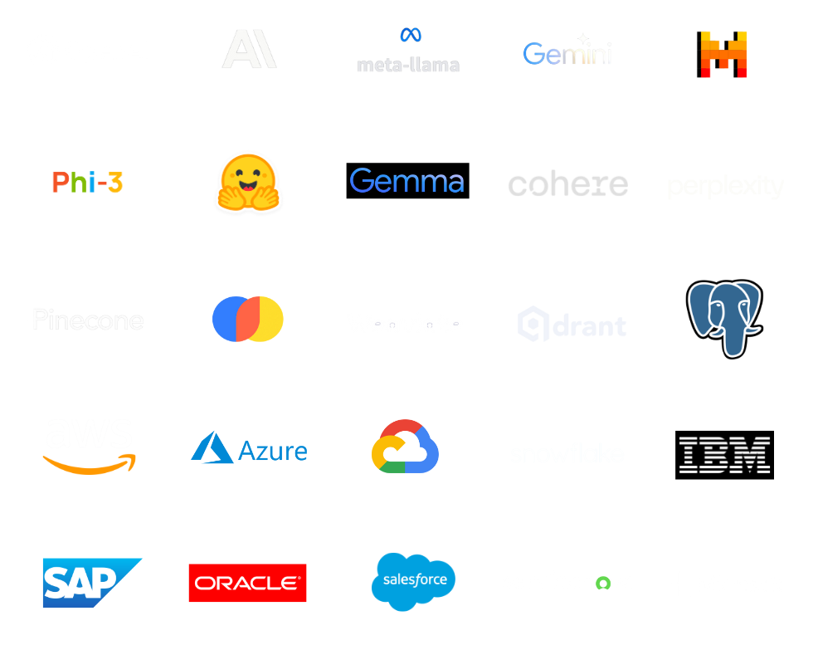
Enterprise Ready
Integrations
- 250+ LLMs
- Runs on all major cloud platforms
- Integrates with enterprise applications
* custom integrations will be built by Lyzr Professional Services team on a need basis

Slide 13
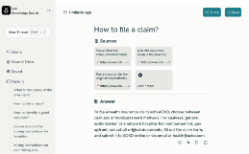
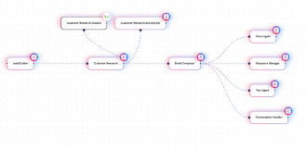
License Based Pricing (No Throttling)
Autonomous Agents
Single-task Agents
Custom Agents
$1999/agent/mo
$399/agent/mo
$399/agent unit/mo
* Customers pay directly to cloud and LLM providers as per usage

Slide 14
- Use Case Discovery
- Fully Paid 3-Month Pilot
- Dedicated Engineering Focus
- No License Fee
- No Charges for Customizations
- No Charges for New Integrations
3-Month Pilot
For Select
Customers

Slide 15
Towards OGI
Website -https://www.lyzr.ai/
Book Demo - https://www.lyzr.ai/book-demo/

