Slide 1
Webinar #2
How To Build GenAI Products Using Current AI Stack?
Date: 7th Feb 2024
Presenter: Siva Surendira, Founder, Lyzr AI
AI SuperAgents
For Your
Business
Private Agent SDKs
Ultra Low-Code Agent Framework
Data Remains in Your Environment

Slide 2
What’s in the menu today?
The 7 Layers of a Generative AI Stack
The Rapid Rise of GenAI Stack
Popular GenAI Use Cases
Decoding a Chatbot Architecture
Built with Lyzr – A PDF QA Bot
Launch with Streamlit
siva@lyzr.ai

Slide 3
Layers of an Enterprise-Grade Generative AI Stack
Compliance and security standards | ISO 42001, SOC2, HIPAA, GDPR
Monitor and track GenAI apps performance. LLM operations in a nutshell. | Lyzr AIMS, Portkey, LLM.Report
The custom application logic and UI UX components of an application | Streamlit, React
The tooling layer which interactions with LLMs and helps you build generative AI applications | Lyzr AI, Langchain, DSPy, LlamaIndex, Cohere
Specialized data stores for LLM apps like Vector Databases | Pinecone, Weaviate, PGVector, ChromaDB
Large Language Models and Diffusion Models | GPT-4, Claude, Gemini, Llama2 7B, Mistral, Phi2.7, Bert 1B, MidJourney, Stability AI, DallE3
The compute power required to run the models, apps, databases | AWS, Amazon Bedrock, Azure, Google Cloud, Google Vertex AI, Nvidia
Compliance
Observability
Custom Workflows
Agent Framework
Data Stores
Foundational Models
Infrastructure

Slide 4
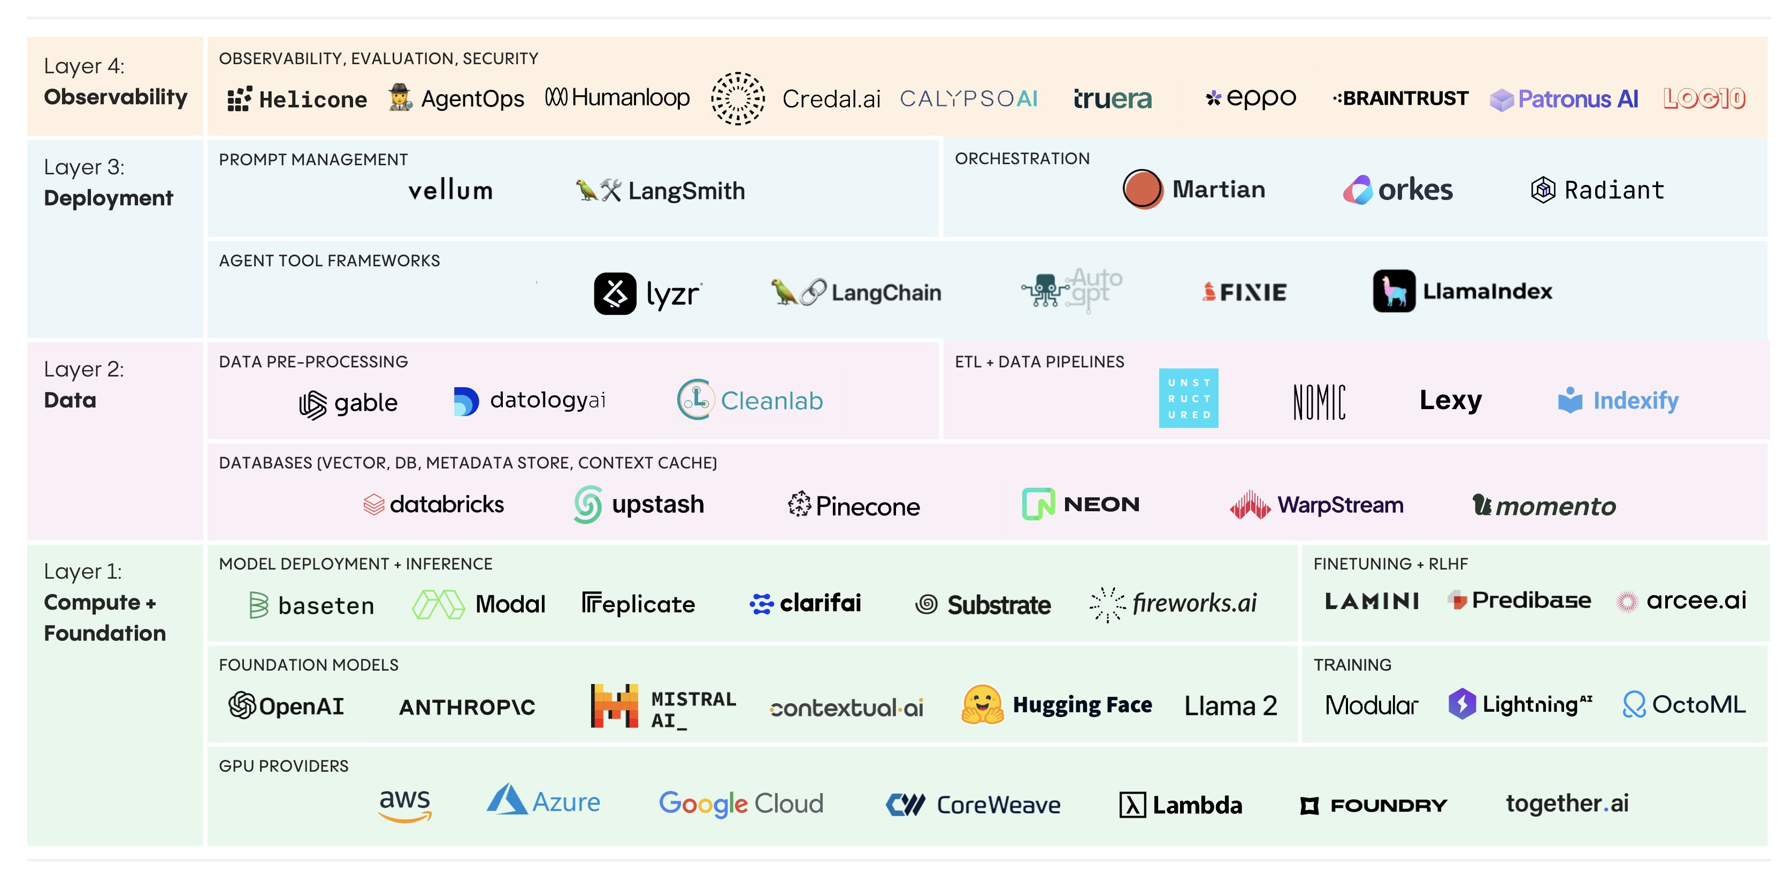
The Growing Modern GenAI Stack

Slide 5
Popular GenAI Use Cases
Chat | Customer Support, Lead Generation, Automated Helpdesk, Process Copilots
Search (RAG) | Enterprise Search, Context-Aware Apps, Document Search, Knowledge Base
Data | Synthetic Data Generation, Conversational Analytics, Data Annotation
Generators & Summarizers | Marketing Content, Product Docs, Customer Reports, Contracts, Email Templates
Automation | Meeting Summarizer, Auto SDR, Auto Blog Writer, Auto Claims Processing,

Slide 6
How to Build GenAI Apps?
Tool | Providers | Build Time | Complexity | Flexibility | Learning Curve
Functions | LangChain, LlamaIndex | High | High | High | Moderate

Slide 7
How to Build GenAI Apps?
Tool | Providers | Build Time | Complexity | Flexibility | Learning Curve
Functions | LangChain, LlamaIndex | High | High | High | Moderate
APIs | Cohere, HuggingFace | Moderate | Moderate | Moderate | Moderate

Slide 8
How to Build GenAI Apps?
Tool | Providers | Build Time | Complexity | Flexibility | Learning Curve
Functions | LangChain, LlamaIndex | High | High | High | Moderate
APIs | Cohere, HuggingFace | Moderate | Moderate | Moderate | Moderate
SDKs | Lyzr | Low | Low | Moderate | Low

Slide 9
How to Build GenAI Apps?
Tool | Providers | Build Time | Complexity | Flexibility | Learning Curve
Functions | LangChain, LlamaIndex | High | High | High | Moderate
APIs | Cohere, HuggingFace | Moderate | Moderate | Moderate | Moderate
SDKs | Lyzr | Low | Low | Moderate | Low
Custom | OpenAI Functions | Very High | Very High | High | High

Slide 10
LLM Powered Chat Agent Architecture

Slide 11
Let’s Build a
PDF QA App

Slide 12
Exclusive Webinar Offer
Contact
siva@lyzr.ai
ani@lyzr.ai
Website
www.lyzr.ai
Your first Generative AI MVP development is on us. Here is what you get,
An MVP built for you on your idea
Includes custom app development
1-year Lyzr Business License

Slide 13
Time for some
Q&A
Contact
siva@lyzr.ai
ani@lyzr.ai
Website
www.lyzr.ai

